Slide 1
4XKanda_1276_NoBME Layout Review Report
Layout file : 4XKanda_1276_NoBME.brd
Date: 12/21/2021

Slide 2
Summary
No. | Description | Status
1 | Copper to copper spacing is too small (~ 2 mils minimum). | OPEN
2 | Copper touched to the solder mask opening. | OPEN
3 | The antenna RF trace and 3V3 trace routed in the keep-out area of ESP32­WROOM­32 module | OPEN
4 | Missing GND via for the thermal pad of ESP32­WROOM­32 module. | OPEN
5 | The antenna RF trace of module RFM69HCW ISM Transceiver (PN: COM-13909) routed in the antenna area of ESP32­WROOM­32 module. | OPEN
6 | The trace routed too close to non-plated through hole (~3.6 mils) . | OPEN
7 | The placement and routing for GPS’ antenna is not good. | OPEN
8 | The solder mask web is too small ( ~ 1.8 mils minimum). | OPEN

Slide 3
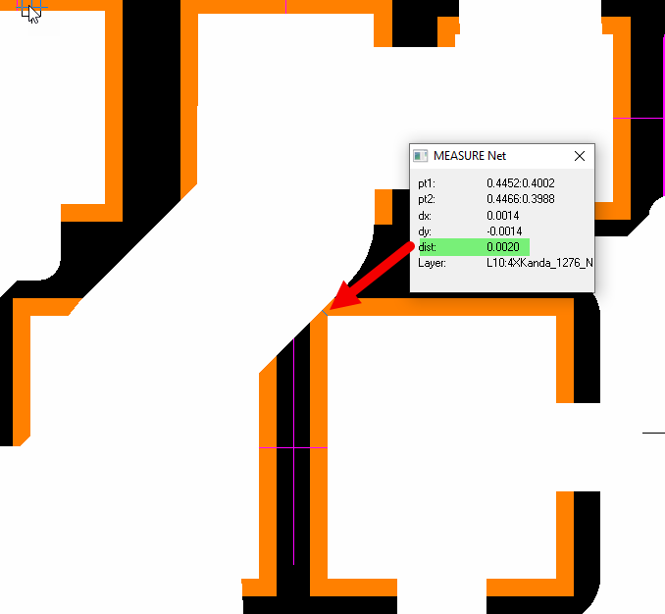
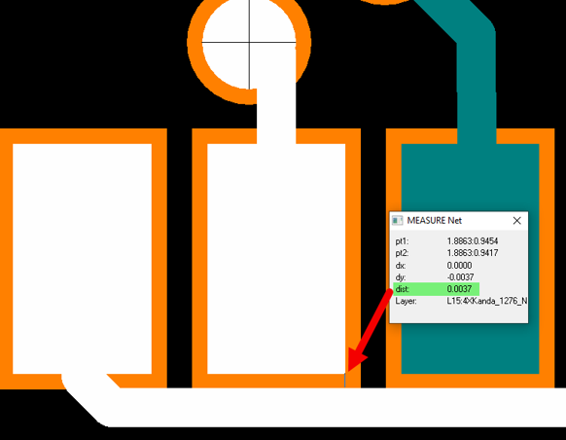
Issue 1: Copper to copper spacing is too small
The copper to copper spacing is less than 4 mils in some areas below. Especially, it’s only 2mil spacing found. It’s a very risk that causes the potential shorted net in the manufacturing process. The shorted net is one of the reasons for PCB hot and failure.
Solutions/Recommendation:
Keep copper to copper spacing to 5 mils minimum.

Slide 4
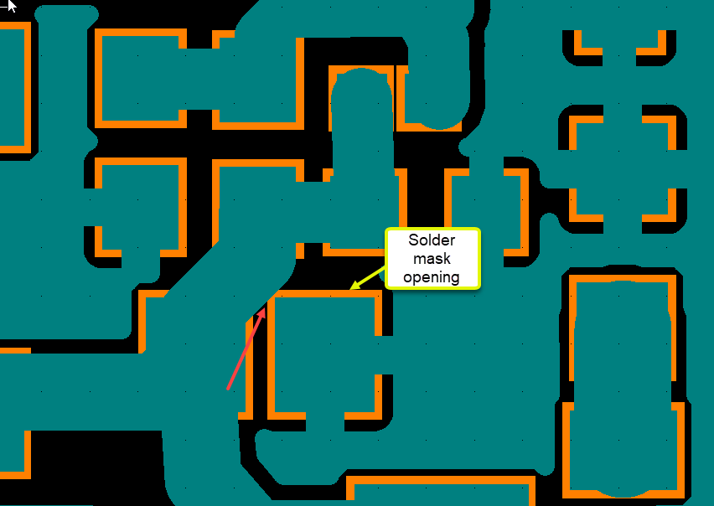
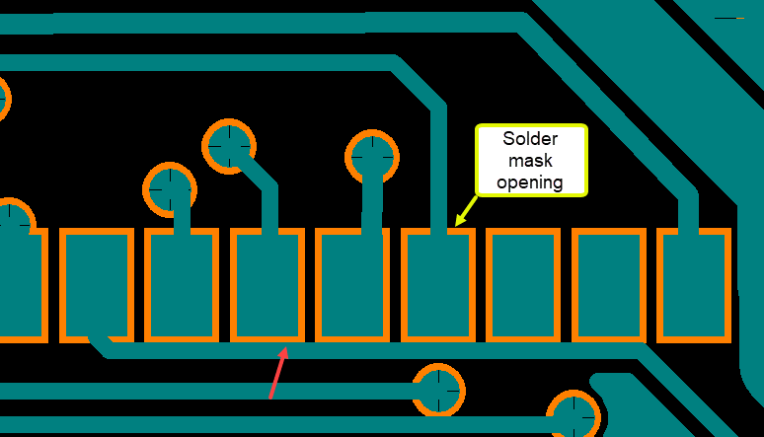
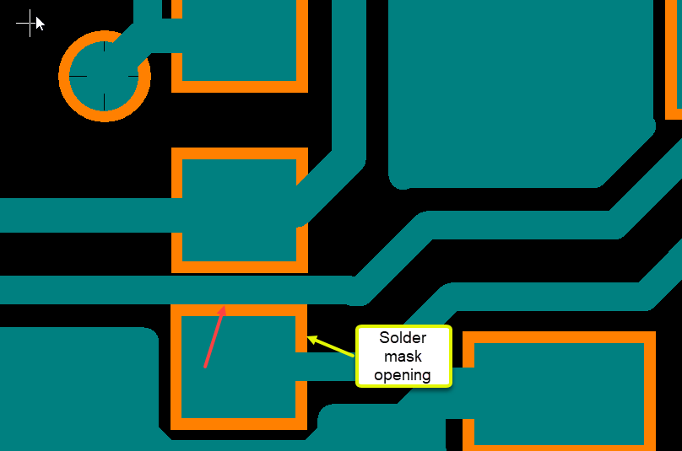
Issue 2: Copper touched the solder mask opening.
This cause the potential solder bridging during assembly.
Solutions/Recommendation:
Move the copper out of the pad solder mask.
Do not route trace/copper running underneath the discrete components

Slide 5
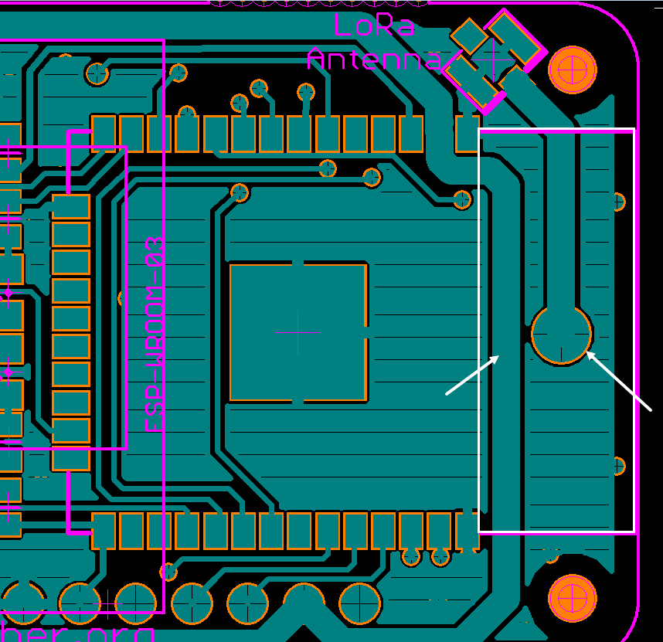
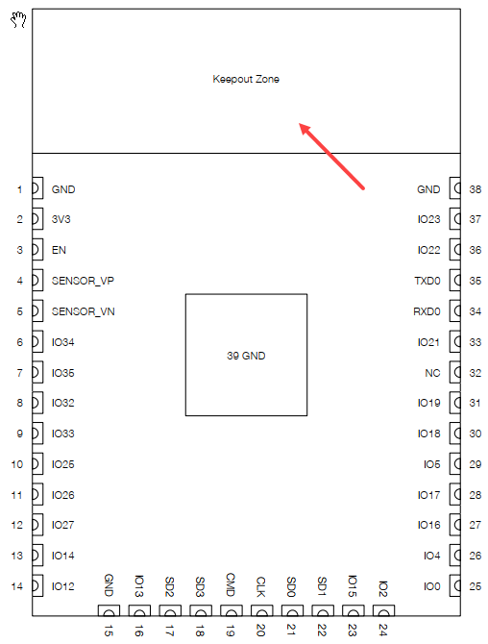
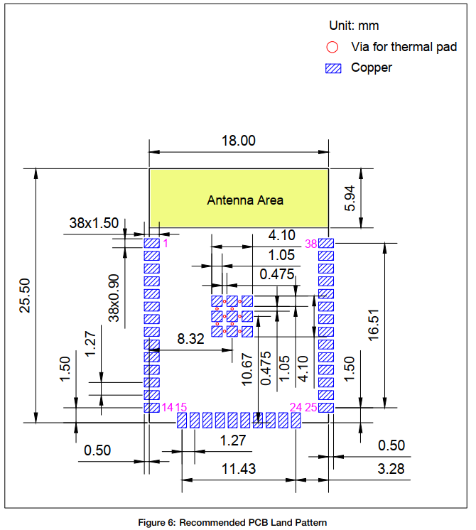
Issue 3: The antenna RF trace and 3V3 trace routed in the keepout area (Antenna area) of ESP32­WROOM­32 module.
This is the potential RF noise issue and RF antenna sensitivity reduction.
Solutions/Recommendation:
Move all signal trace/power trace out of the antenna keepout area per datasheet recommended.

Slide 6
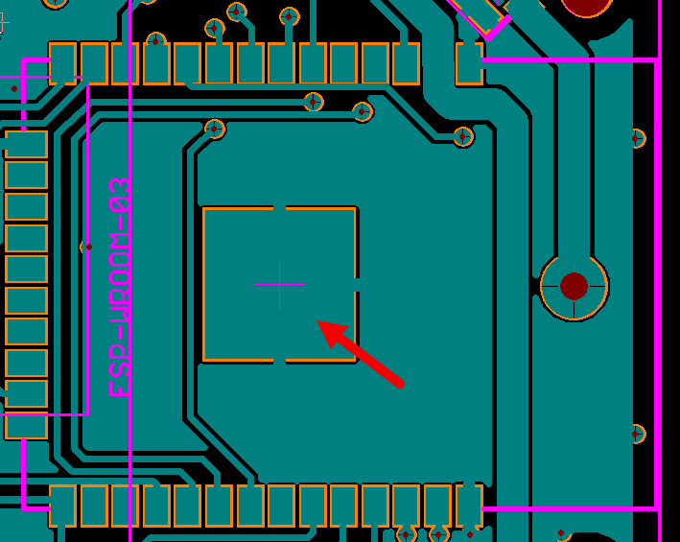
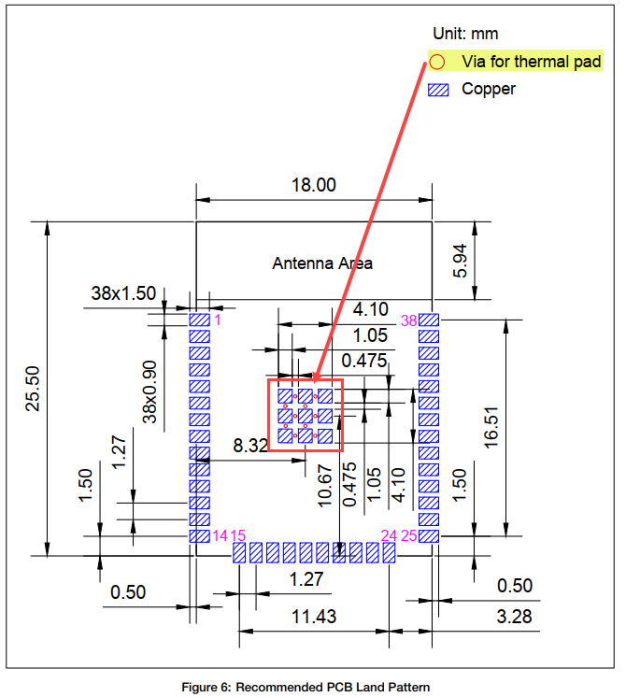
Issue 4: Missing GND vias for thermal pad of ESP32­WROOM­32 module.
Solutions/Recommendation:
To improve thermal dissipation performance:
Add more vias for thermal pad per datasheet recommended
Suggest to connect thermal pad to full copper planes, no thermal spoke as the current layout

Slide 7
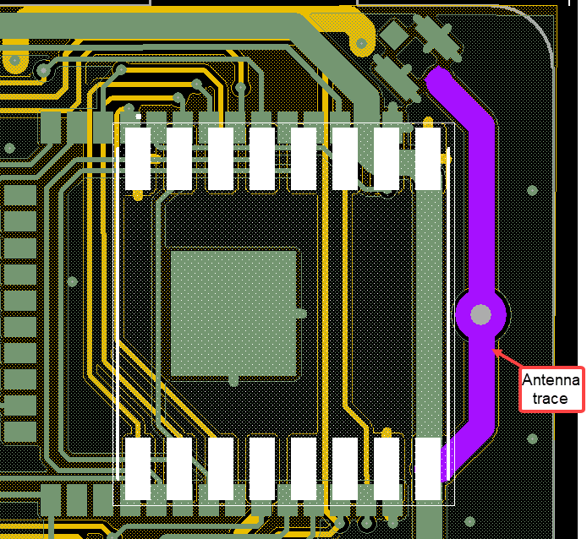
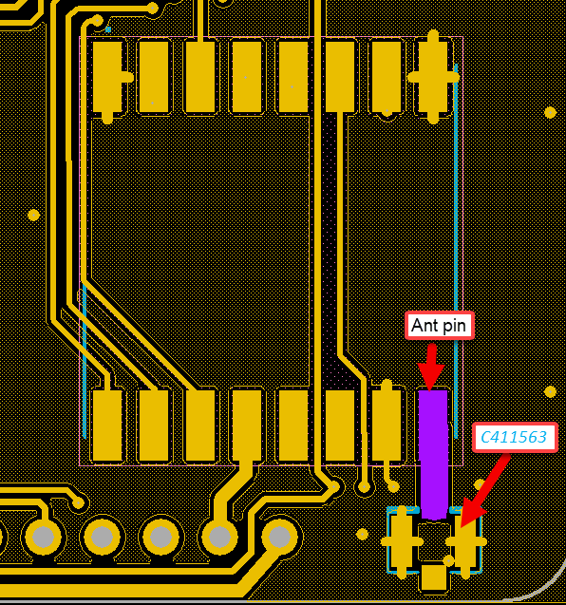
Issue 5: The antenna RF trace of module RFM69HCW ISM Transceiver (PN: COM-13909) routed in the antenna area of ESP32­WROOM­32 module.
This is the potential RF noise issue and RF antenna sensitivity reduction.
Solutions/Recommendation:
Move the antenna connector (IPEX Conn C411563) to close to the antenna pin of the module RFM69HCW on the bottom side.
Route the antenna trace length as short as possible without transition via as example below.

Slide 8
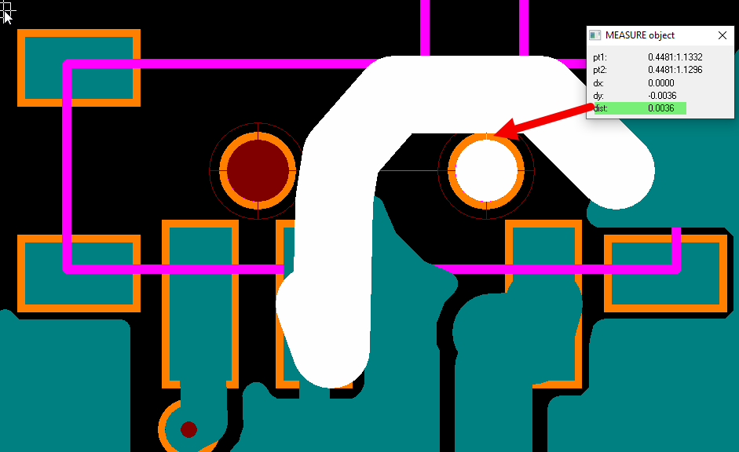
Issue 6: The trace routed too close to non-plated through hole (~3.6 mils).
Solutions/Recommendation:
We recommend to keep 8-10 mils copper spacing to non-plated through hole to void the fab/assembly DFM issues.

Slide 9
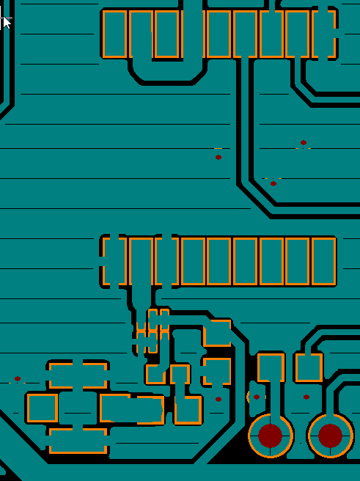
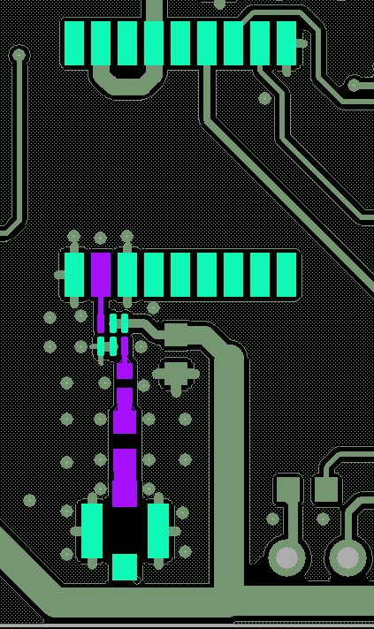
Issue 7: The placement and routing for GPS antenna is not good
Solutions/Recommendation:
We recommend to re-do layout for GPS antenna as below to improve the RF antenna sensitivity.

Slide 10

Issue 8: The solder mask web is too small ( ~ 1.8 mils minimum).
This cause the potential solder bridging during assembly.
Solutions/Recommendation:
Keep the solder mask web to 3 mils minimum per DFM rule so that we have the solder mask dam between two pads to avoid the potential solder bridging during assembly.

